Slide 1
Knowledge Representation

Slide 2
So far . . .
The previous chapters described the technology for knowledge-based agents:
  the syntax, semantics, and proof theory of propositional and first-order logic
  and the implementation of agents that use these logics.
Now address the question of
  what content to put into such an agent's knowledge base
  how to represent facts about the world.

Slide 3
Outline
  a general ontology
  the basic categories
  representing actions
  reasoning about categories

Slide 4
Ontological Engineering
Complex domains
  Ex: internet shopping agents, driving a car in traffic
  require very general & flexible representations
    should include actions, time, physical objects, beliefs, ….
  This chapter addresses on how to create such abstract representations
  Referred as Ontological engineering
    is the process of finding/deciding on representations for these abstract concepts
  somewhat like Knowledge Engineering
    but at a larger scale
    generalized to a more complex real world

Slide 5
Ontological Engineering
Representing everything in the world is daunting
Instead leave placeholders where new knowledge for any domain can fit in.
Ex: define a physical object
  and the details of different types of objects-robots, televisions, books can be filled in later
Analogous to the way that designers of an object-oriented programming framework (such as the Java Swing graphical framework) define general concepts like Window
  Expect users to define more specific concepts like SpreadsheetWindow

Slide 6
Ontological Engineering
The general framework of concepts is known as
  an upper ontology
    "upper" due to the diagrammatic convention of putting the most general at the top

Slide 7
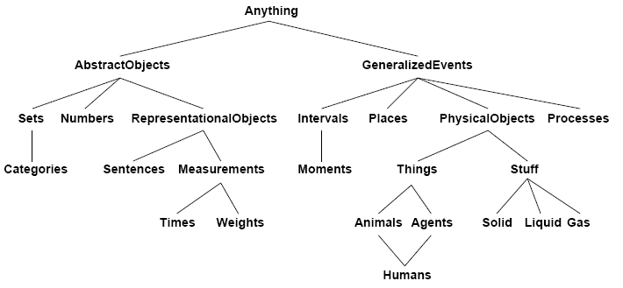
Ontological Engineering
a sample upper ontology

Slide 8
Ontological Engineering
We use first-order logic (FOL) to discuss the content and organization of knowledge
Previous chapters have omitted them
  there are limitations to a FOL representation
  Ex: there are exceptions to generalizations
    they hold only to some degree
    "tomatoes are red"
    but there are green, yellow, even purple tomatoes
  exceptions & uncertainty are important topics
    however, they are orthogonal to a general ontology
      their discussions are deferred
      uncertainty later in Ch 13
Notes:
Orthogonal:直交的

Slide 9
Ontological Engineering
Is there one general purpose ontology?
  the philosophical answer is: Possibly

Slide 10
Ontological Engineering
Goal
  develop a general purpose ontology
  one that's usable in any special purpose domain
    with the addition of domain-specific axioms
  in any sufficiently demanding domains
    different areas of knowledge must be unified
    involves several areas simultaneously
  We will use it later for the internet shopping agent example

Slide 11
Background on Ontologies

Slide 12
Ontology Examples
Taxonomies on the Web
  Yahoo! categories
Catalogs for on-line shopping
  Amazon.com product catalog
Domain-specific standard terminology
  Unified Medical Language System (UMLS)
  UNSPSC - terminology for products and services

Slide 13
What Is “Ontology Engineering”?
Ontology Engineering: Defining terms in the domain and relations among them
  Defining concepts in the domain (classes)
  Arranging the concepts in a hierarchy (subclass-superclass hierarchy)
  Defining which attributes and properties (slots) classes can have and constraints on their values
  Defining individuals and filling in slot values

Slide 14
Why Develop an Ontology?
To share common understanding of the structure of information
  among people
  among software agents
To enable reuse of domain knowledge
  to avoid “re-inventing the wheel”
  to introduce standards to allow interoperability

Slide 15
An Ontology Is Often Just the Beginning
Databases
Declare
structure
Ontologies
Knowledge
bases
Provide
domain
description
Domain-independent
applications
Software agents
Problem-solving methods

Slide 16
Consider Reuse
determine
scope
consider
reuse
enumerate
terms
define
classes
define
properties
define
constraints
create
instances
Why reuse other ontologies?
  to save the effort
  to interact with the tools that use other ontologies
  to use ontologies that have been validated through use in applications

Slide 17
What to Reuse?
Ontology libraries
  DAML ontology library (www.daml.org/ontologies)
  Ontolingua ontology library (www.ksl.stanford.edu/software/ontolingua/)
  Protégé ontology library (protege.stanford.edu/plugins.html)
Upper ontologies
  IEEE Standard Upper Ontology (suo.ieee.org)
  Cyc (www.cyc.com)

Slide 18
What to Reuse? (II)
General ontologies
  DMOZ (www.dmoz.org)
  WordNet (www.cogsci.princeton.edu/~wn/)
Domain-specific ontologies
  UMLS Semantic Net
  GO (Gene Ontology) (www.geneontology.org)

Slide 19
Ontology Engineering versus
Object-Oriented Modeling
An OO class structure
reflects the structure of the data and code
is usually about behavior (methods)
describes the physical representation of data (long int, char, etc.)
An ontology
reflects the structure of the world
is often about structure of concepts
actual physical representation is not an issue

Slide 20
Categories and Objects

Slide 21
Ontological Engineering
we begin with objects & categories
Categories:
The organization of objects into categories is a vital part of knowledge representation
  organizing objects into categories
    though interaction with the world involves individual objects
    reasoning takes place at the level of categories
Ex: a shopper might have the goal of buying a basketball, rather than a particular basketball such as BB.

Slide 22
Objects & Categories
FOL representation of categories (Alternative approaches)
  1. use predicates
    Basketball (b)
    then the category as the set of its members
  2. or, treat the category as an object
    reify the category: Basketballs
    allows Member(b, Basketballs) or b ∈ Basketballs to say that b is a member of the category of basketballs
    allows Subset(Basketballs, Balls) or BasketBalls ⊂ Balls to say that Basketballs is a subcategory of Balls.
Note: the terms subcategory, subclass, and subset are used interchangeably
Reify-the conversion of an abstract concept into something concrete; a viewing of the abstract as concrete.

Slide 23
Category Organization
The category mechanism
  1. organizes & simplifies a KB through inheritance
    Ex: All instances of category Food are edible
    Now assert the following
      fruit is a subclass of food
      apples is a subclass of fruit
    then an apple is edible
  2. subclass relations organize categories into a taxonomy or taxonomic hierarchy
      as used in the natural sciences: botany, biology, ...
      many other disciplines such as tax authorities have developed extensive taxonomies of occupations and commercial products
      Dewey Decimal system in library science developed a taxonomy of all fields of knowledge
Notes:
Taxonomy:分类学

Slide 24
FOL & Categories
Expressiveness of FOL
  state facts about categories
    relating objects to categories
    or quantify over members of categories
  express relations between categories
    disjoint
      no members in common between categories
    exhaustive decomposition
      any individual must be in one of the categories
    partition
      an exhaustive disjoint decomposition of a category

Slide 25
FOL & Categories
Categories:
  1. state facts & quantify over members
    An object is a member of a category. For example:
    BB ∈ Basketballs
    A category is a subclass of another category. For example:
    Basketballs ⊂ Balls
    All members of a category have some properties. For example:
    x ∈ Basketballs ⇒ Round (x)

Slide 26

FOL & Categories
    Members of a category can be recognized by some properties. For example:
      Orange(x) ∧ Round(x) ∧ Diameter(x)=9.5” ∧ x ∈Balls ⇒ x ∈ Basketballs
    A category as a whole has some properties. For example:
      Dogs is a category and is a member of DomesticatedSpecies, so the DomesticatedSpecies is a category of categories.
  Hence the more general categories are categories of categories

Slide 27
Relations Among Categories
2. express relations between categories that are not subclasses of categories
  A. disjoint categories
  for s, a set of categories and c1, c2 as categories
    two or more categories are disjoint if they have no members in common
    a predicate Disjoint defined as follows
Disjoint(s) ⇔
(∀ c₁,c₂ c₁∈s Λ c₂∈s Λ c₁≠ c₂ Intersection(c₁,c₂) ={})
    example: Disjoint ({Animals, Vegetables})

Slide 28
Relations Among Categories
B. exhaustive decomposition
  for a category c, c1 and c2
    any individual must be in one of the categories
      a set of categories s is an exhaustive decomposition of a category c if all members of the set c are covered by categories in s
      predicate ExhaustiveDecomposition is defined as follows
ExhaustiveDecomposition
(s,c) ⇔ (∀i i∈c ⇔ ∃c₂ c₂∈s Λ i∈c₂)
    example: ExhaustiveDecomposition({Americans, Canadians, Mexicans}, NorthAmericans)

Slide 29
Relations Among Categories
C. partition
  a partition is a disjoint exhaustive decomposition
      the predicate Partition is defined as follows
Partition (s, c) ⇔ Disjoint(s) Λ ExhaustiveDecomposition(s, c)
    example: Partition({Males, Females}, Animals)

Slide 30
FOL & Categories
categories may also be defined
  in terms of necessary & sufficient conditions for membership
  example: a bachelor is an unmarried adult male
    x ∈ Bachelors ⇔ Unmarried (x) Λ x ∈ Adults Λ x ∈ Males

Slide 31
Reasoning About Categories
Organizing & reasoning with categories
  the semantic networks approach
  conveniently represents
    objects and categories of objects
    plus some relations among them
  was originally proposed (early 20th century)
    as an alternative to conventional logic
  semantic network approach
    turns out, when fully analyzed is actually a form of logic with an alternative notation, syntax

Slide 32
Reasoning About Categories
Semantic networks
  visualize the knowledge base as a graph
    nodes (bubbles) are categories & individual objects
    links are Subset & MemberOf relations
  this type of representation
    allows very efficient algorithms, for category membership inference
    just follow links upward

Slide 33
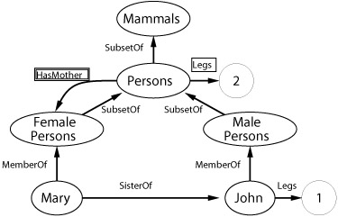
Semantic Networks
Inheritance reasoning in semantic nets
  follow MemberOf & SubsetOf links
    up the hierarchy
  stop at the category with a property link
    to infer the property for an individual

Slide 34
Semantic Networks
The representation allows other relations
  to be captured in additional arcs

Slide 35
Semantic Networks
Inheritance reasoning in semantic nets
  1. an example: the HasMother relation
    applies between individuals, not categories
    this is indicated by the double box special notation

Slide 36
Semantic Networks
Inheritance reasoning in semantic nets
  2. multiple MemberOf, SubsetOf links are possible
    but multiple inheritance may produce conflicting values
  3. properties of every member of a category
    are indicated by the single box notation
  4. standard links represent binary relations

Slide 37
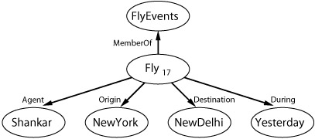
Semantic Networks
Inheritance reasoning in semantic nets
  4. standard links represent binary relations
    n-ary relations can be represented
    example: Fly (Shankar, NewYork, NewDelhi, Yesterday)
    process for representing n-ary relations involves
      reifying the proposition as an event in an appropriate event category so Fly (Shankar, NewYork, NewDelhi, Yesterday)

Slide 38
Semantic Networks
Summary
  the semantic net advantages
    simplicity of inference
    ease of visualizing, even for large nets
    ease of representing default values for categories
    ease of overriding defaults by more specific values
  but, awkward or impossible
    to capture many of FOL's representational capabilities
    negation, disjunction, existential quantification, ...
    when extended to do so, it loses its attractive simplicity

